Slide 1
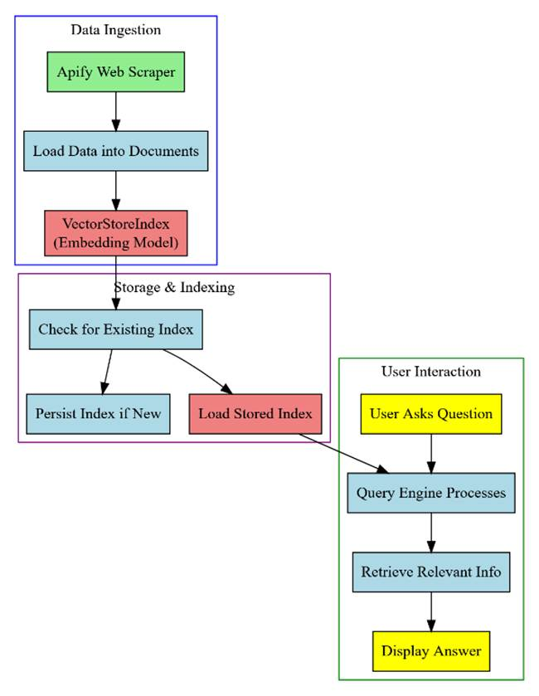
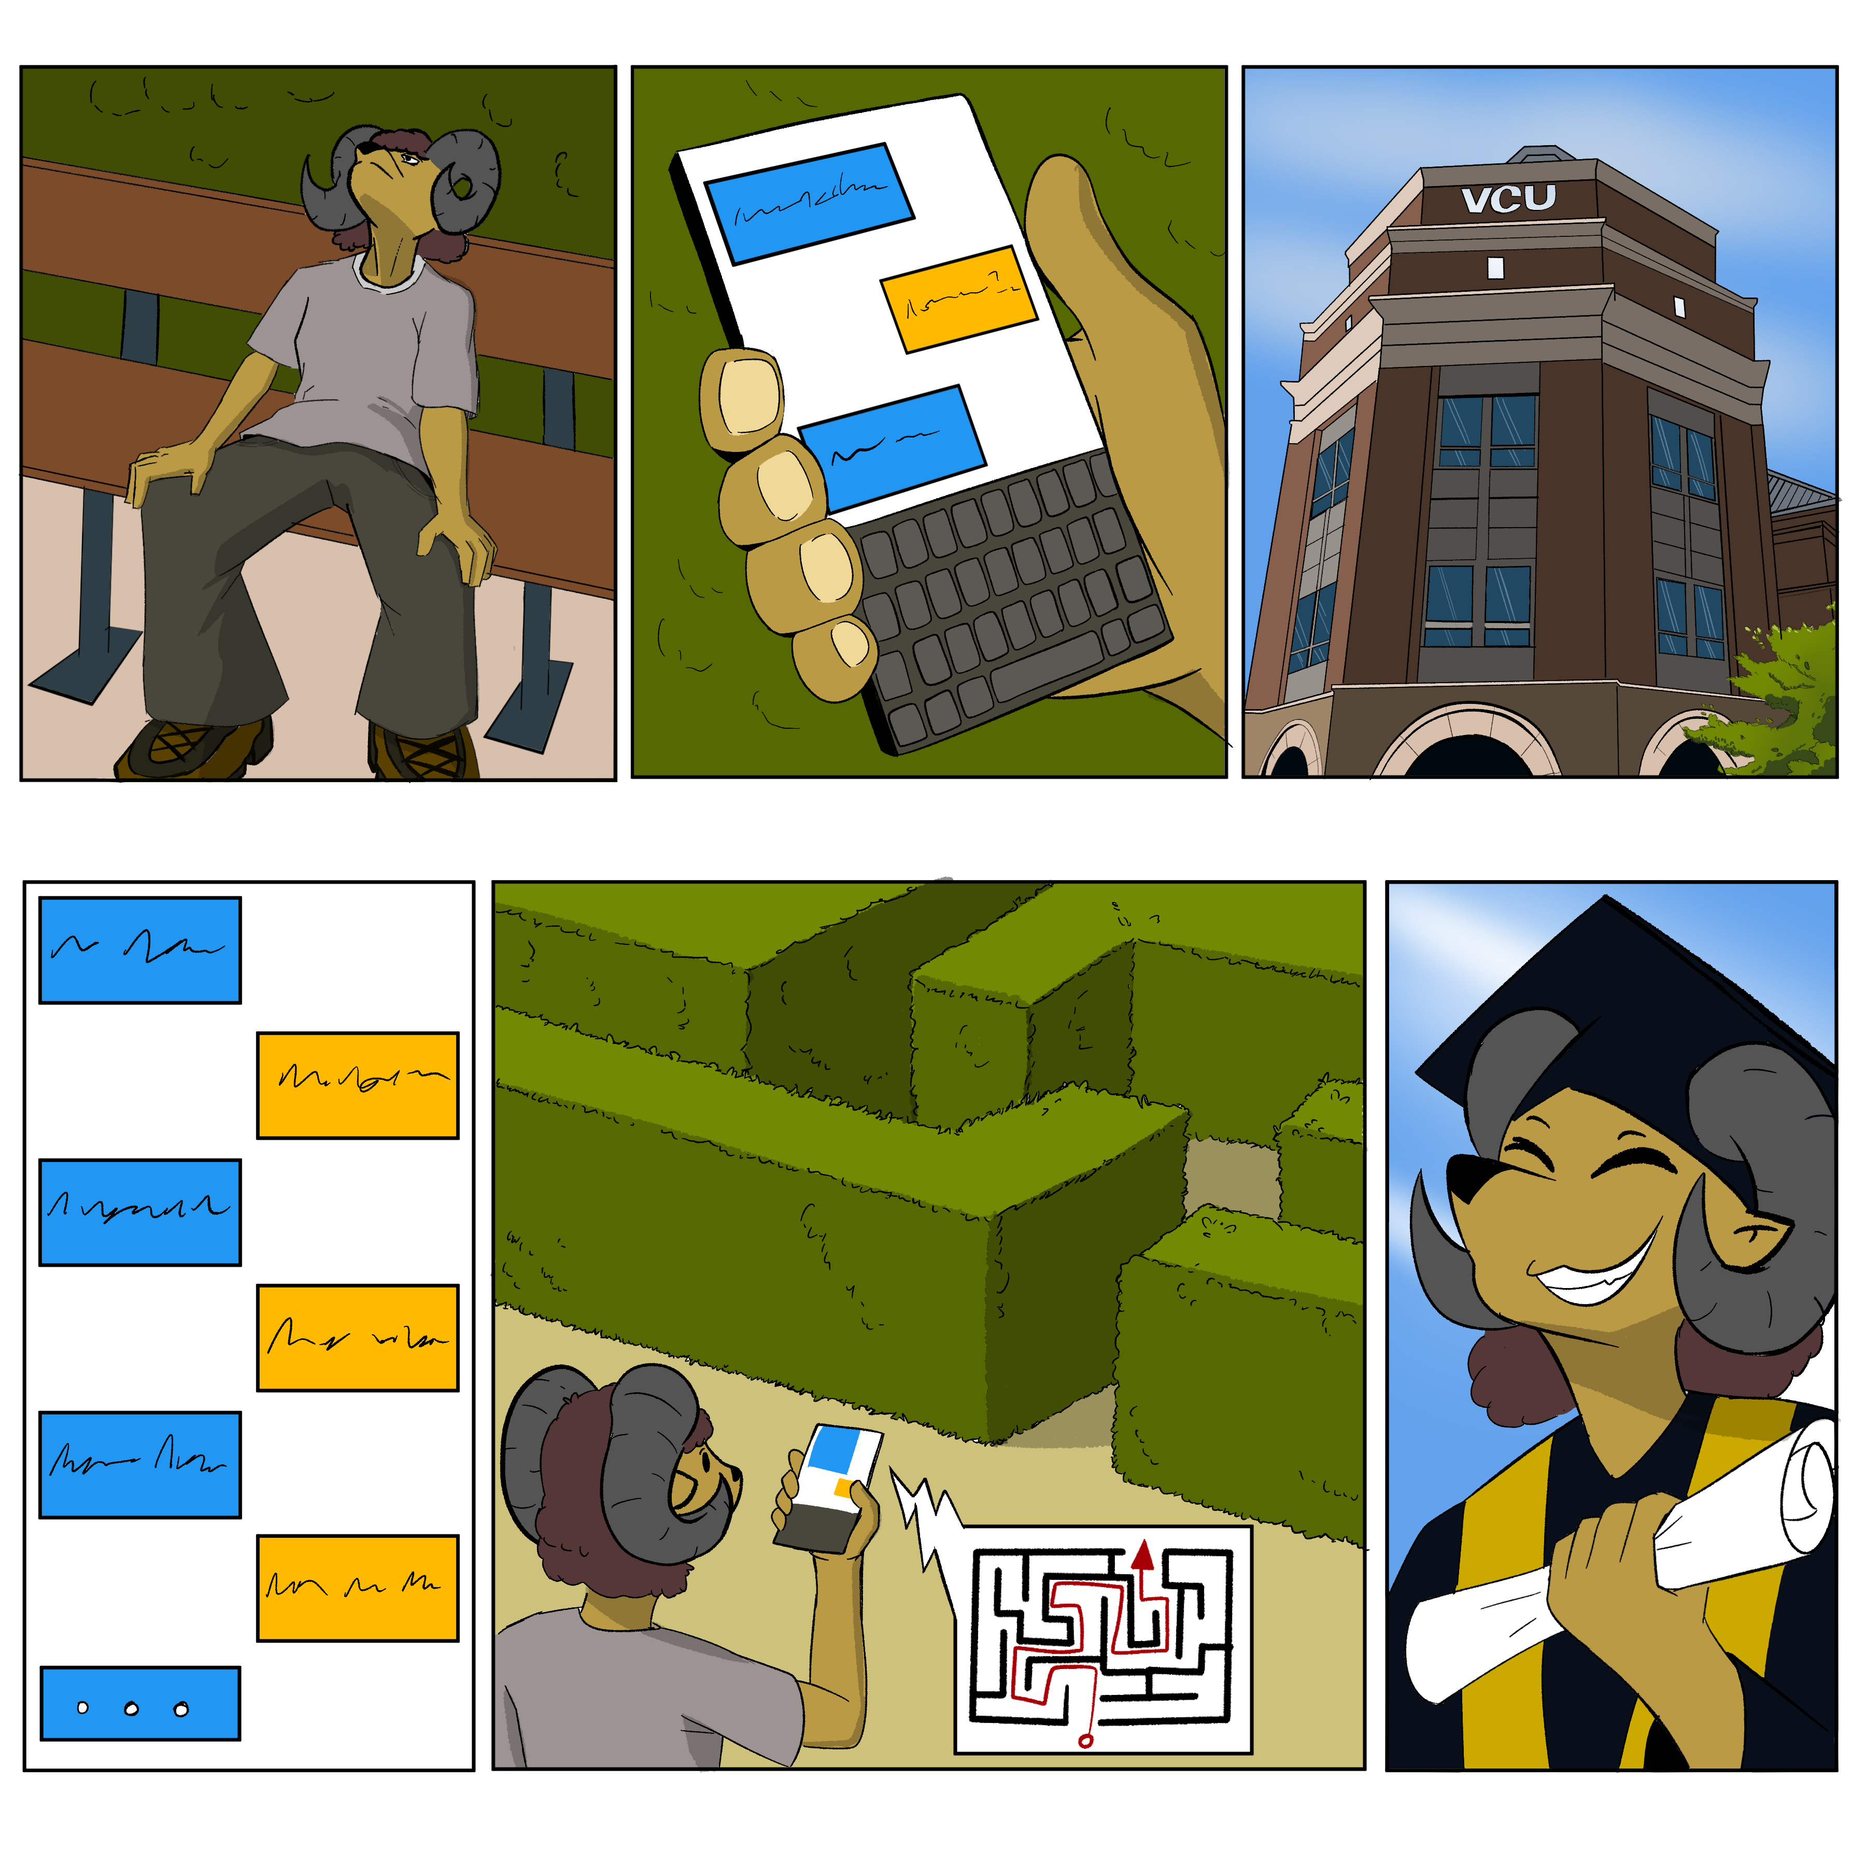


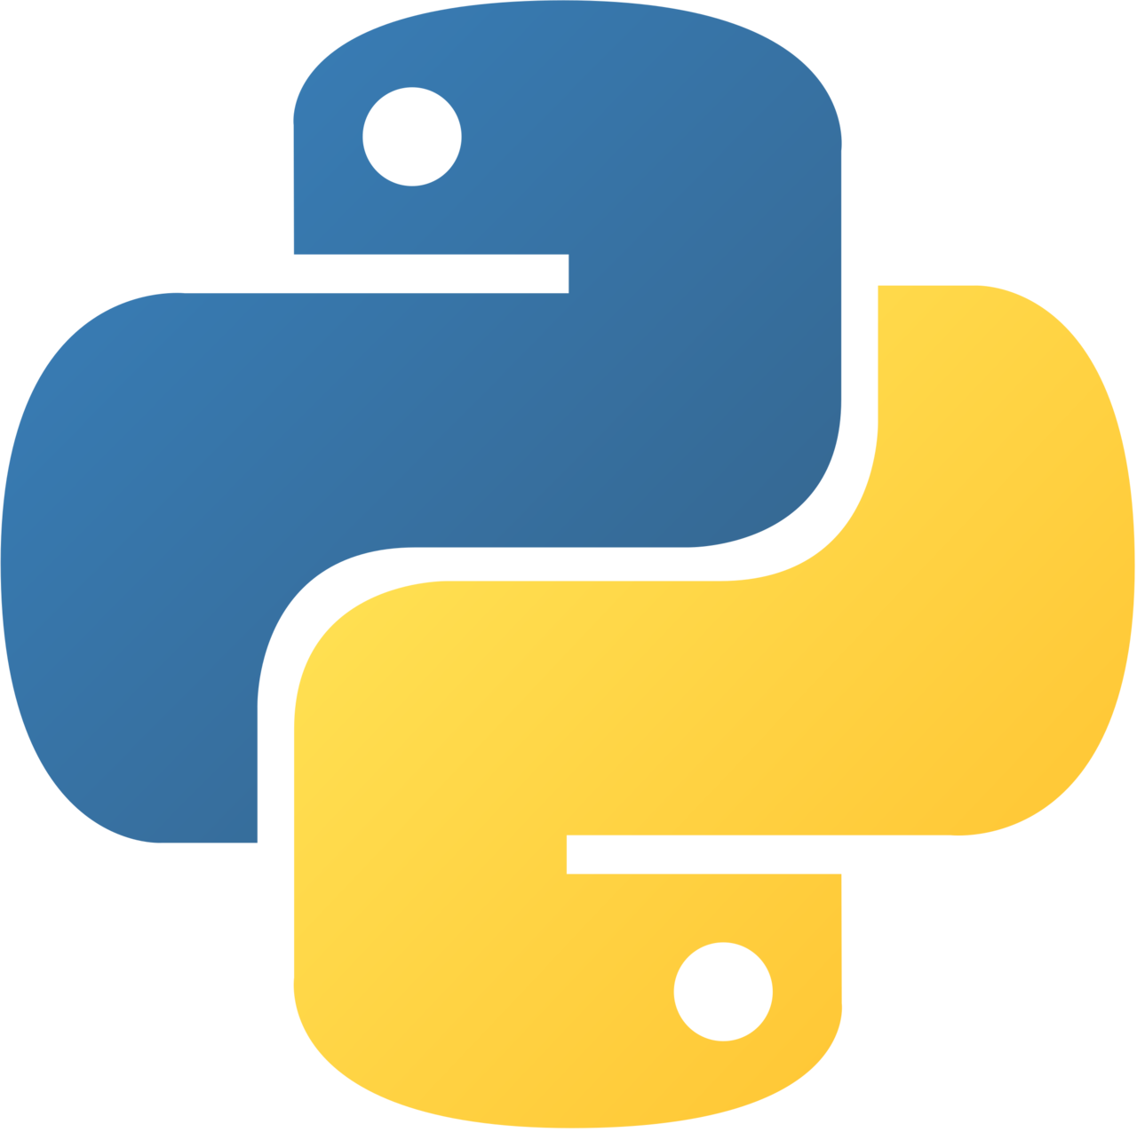



25-314
Computer Science Chatbot
Team members: Kennedy Martin, Israel Agoe-Sowah, Eric Simoni, Antony Fuentes | Faculty adviser: Caroline Budwell, Ph.D. | Sponsor: Virginia Commonwealth University |
Overview
Features
Goal:
Build a chatbot for the VCU Computer Science webpages
The chatbot will answer FAQ’s about the program for current or incoming undergraduate students
Why:
Provides accurate information
Serves as a main source of program information
Saves faculty resources
Retrieval Augmented Generation:
Utilize Apify web scrapers to retrieve the content from web pages
Utilize OpenAI and LlamaIndex for embeddings and response generation
FastAPI and WebSockets:
Supports asynchronous communication for handling multiple users efficiently
Supports real-time chat through seamless WebSocket integration
ROI
Significant advantage in terms of cost associated with implementation and maintenance compared to Rambot
Our implementation costs lie in OpenAI credit usage: <.01 per query and response
Scalable to other departments at minimal additional cost and effort
Next Steps
Rigorous testing with WebSockets to ensure simultaneous multi-user functionality
Create an administrator dashboard to resolve unanswered queries
Potential authentication implementation
Implement “Ramsey” instances on chosen VCU web pages
Ask Ramsey!

